Slide 1
Deep Fake Detection
Group Members:
Michael Cortez
Francisco Tejeda-Villarreal
Xavier Cristan
Raphael Pangilinan

Slide 2
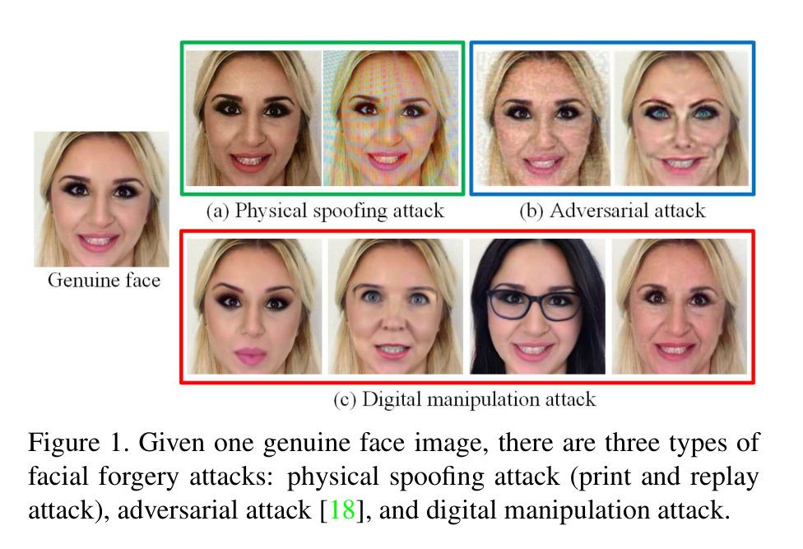
Problem Statement and Motivation:
Deepfake technologies has raised major ethical and societal concerns
- privacy invasion
- identity misuse
- spread of manipulated content

Slide 3
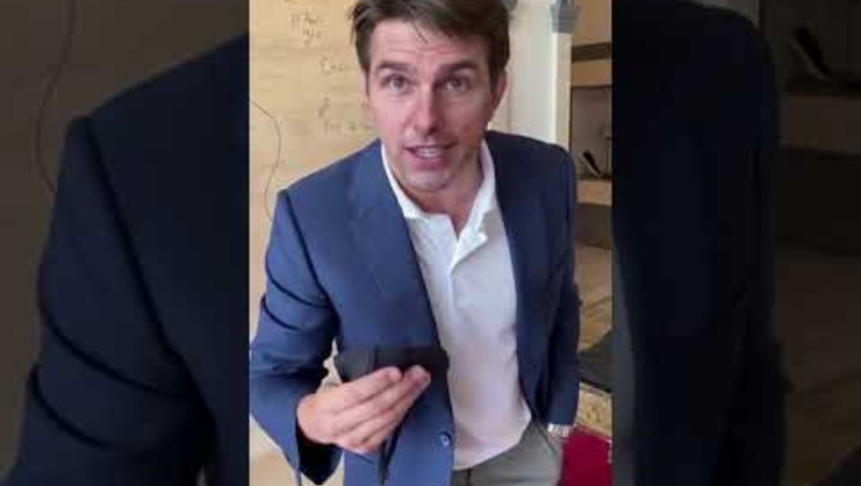

Slide 4
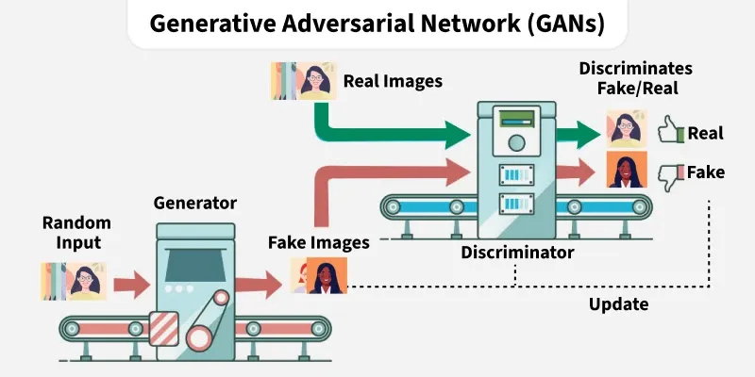
Face-Swapped Image Generation
Common architectures for face-swap generation
Generative Adversarial Networks (GANs)
  Generator makes fake images, Discriminator tries to spot them
  Each improves against the other until fakes look real
Variational Autoencoders (VAEs)
  Encoder compresses an image into latent code, and a decoder rebuilds it
Diffusion Models
  Train by gradually adding noise to images, learn to reverse it
  Generate by starting from pure noise and denoising step by step

Slide 5
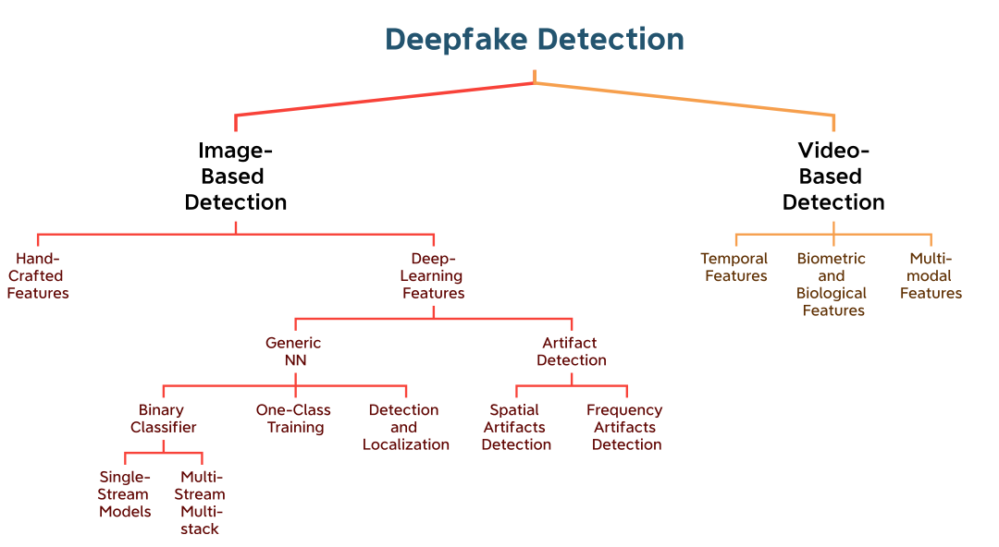
Detection
Detection methods split into image-based and video-based
Image based methods operate on individual frames
Video based methods leverage temporal continuity to detect motion inconsistencies

Slide 6
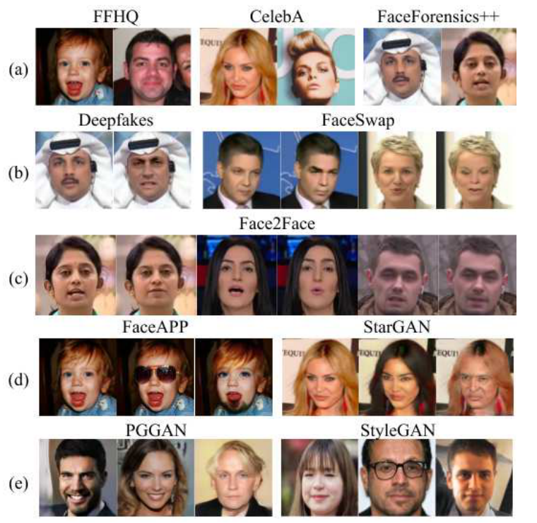
Dataset - Images
Diverse FakeFace Dataset (DFFD)
58,703 Real Images
240,336 Fake Images (Identity / Expression Swap)
Generated using FaceAPP and StarGAN
Probably use a subset of the images

Slide 7
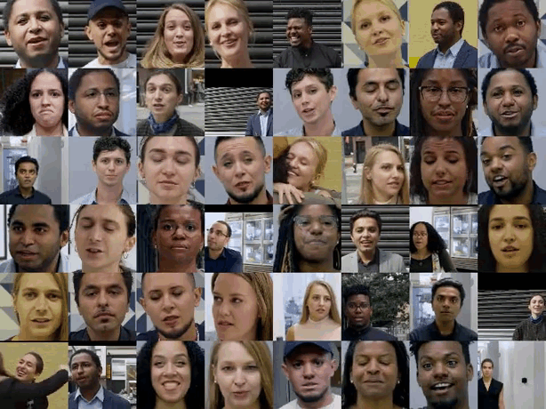
Dataset - Video
DeepFake Detection Dataset (DFD)
Released by Google and Jigsaw (2019)
363 real videos 3,068 face-swapped videos of 28 paid actors
Presumed to be generated by an autoencoder-based method
Work on video detection if time allows

Slide 8
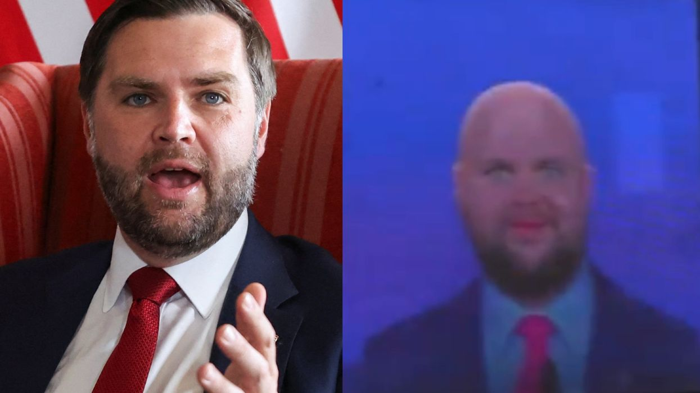
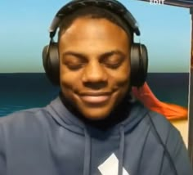
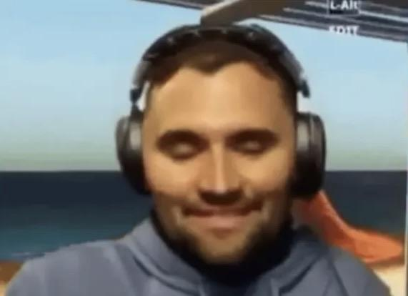
Methodology
Many potential architectures:
shallow CNN
CNN + Attention
ResNet-18
Variational Autoencoder
8 Step Forward Pass
Digital Ingestion and Sampling -> Face Localization and Alignment -> Margin Expanded Face cropping -> Forensic Degradation Augmentation -> Dual Domain Feature extraction -> Feature Fusion and Cross Attention -> temporal Dynamics Modeling -> Classification Scoring

Slide 9
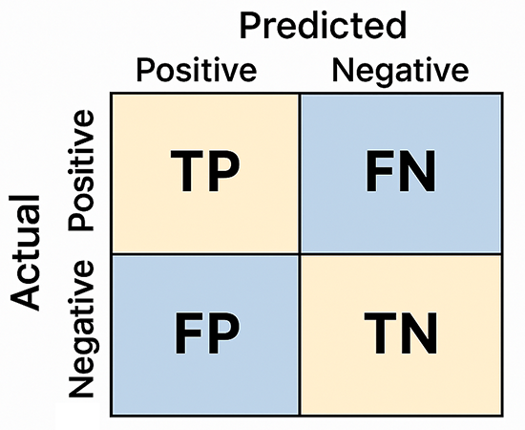
Model Evaluation
A few metrics for evaluating the model:
Accuracy
Precision
Recall
F1 Score
Area Under the ROC Curve
Confusion Matrix

Slide 10
References
G. Pei et al., “Deepfake Generation and Detection: A Benchmark and Survey,” ACM Comput. Surv., vol. 58, no. 11, pp. 1–41, Aug. 2026, doi: 10.1145/3801962.
S. A. R. Syed Abu Bakar, S. Waseem, Z. Omar, and Bilalashfaqahmed, “Exploring the Advancements and Challenges of Deepfake Face-swap: A Survey,” Multimed Tools Appl, vol. 85, no. 1, p. 14, Jan. 2026, doi: 10.1007/s11042-026-21285-8.
Google AI, “Contributing Data to Deepfake Detection Research.” Accessed: Sep. 28, 2026. [Online]. Available: https://research.google/blog/contributing-data-to-deepfake-detection-research/
H. Dang, F. Liu, J. Stehouwer, X. Liu, and A. K. Jain, “On the Detection of Digital Face Manipulation,” in 2020 IEEE/CVF Conference on Computer Vision and Pattern Recognition (CVPR), Seattle, WA, USA: IEEE, Jun. 2020, pp. 5780–5789. doi: 10.1109/CVPR42600.2020.00582.

